Slide 1
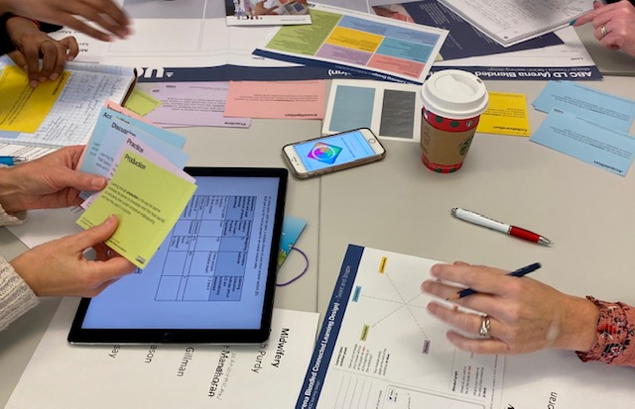
UCL Programme development
ABC
LEARNING
DESIGN
UCL Programme
Development
@ABC_LD

Slide 2
ABC used at UCL since 2015
Workshop brings module and programme teams together
Fast, student-centred, activity based method
Conversation, creativity, consensus
Practical outcomes – a storyboard and action list
Works across disciplines
Online and face-to-face

Slide 3
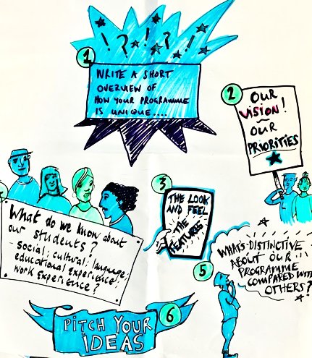
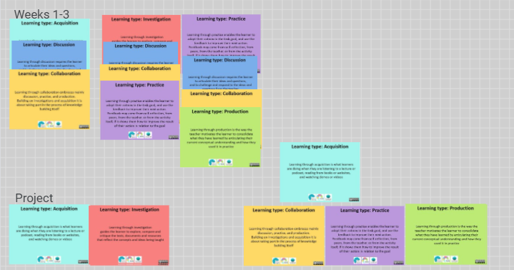
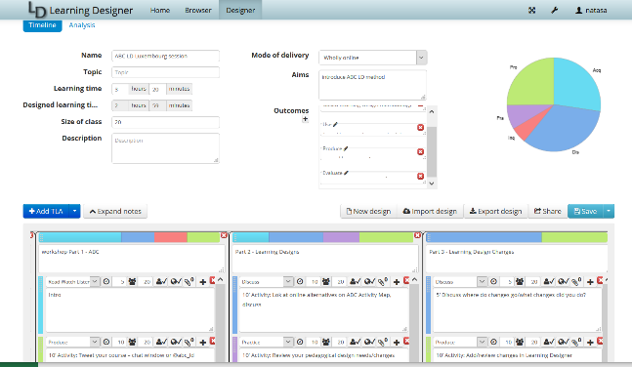
Now part of an end-to-end design process
INITIATION
DESIGN SUPPORT (LD, etc)
DEVELOPMENT SUPPORT
PROGRAMME DESIGN
VALIDATION
MODULE DESIGN (ABC)

Slide 4
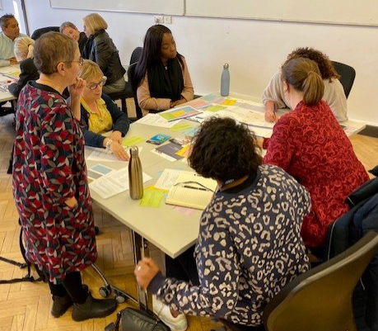
Originally face-to-face format, now online too
Blended and online learning
New programmes, modules (post PMAP usually)
Programme etc. review
Specific topics (e.g. employability)
Short courses, MOOCs
UCL Online Learning team

Slide 5
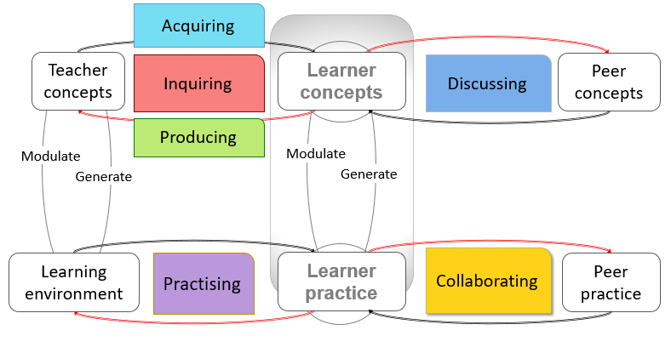
6 types of learning based on ‘conversational framework’ (Laurillard 2002, 2012)

Slide 6
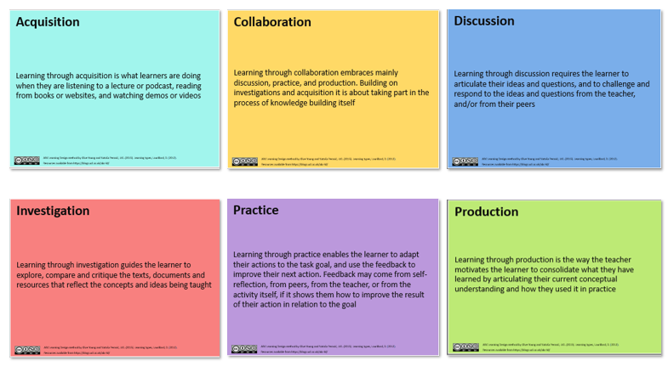
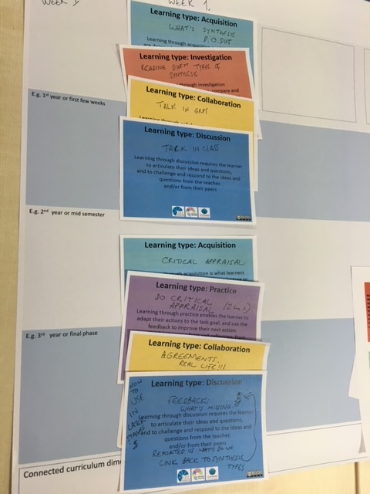
Six learning types represented by cards – ABC encourages active learning
“CONTENT”

Slide 7
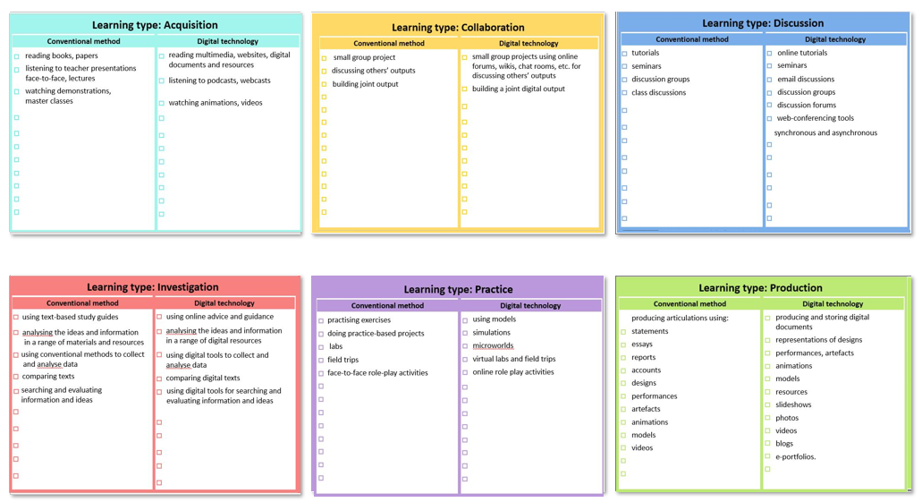
Six learning types represented by cards – ABC encourages blended learning

Slide 8
ABC Learning Design

Slide 9
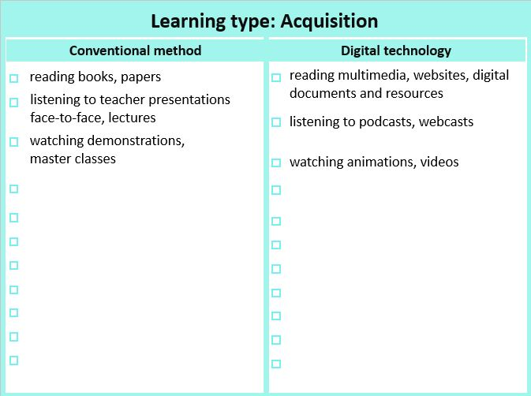
ABC Learning Design

Slide 10
ABC Learning Design

Slide 11
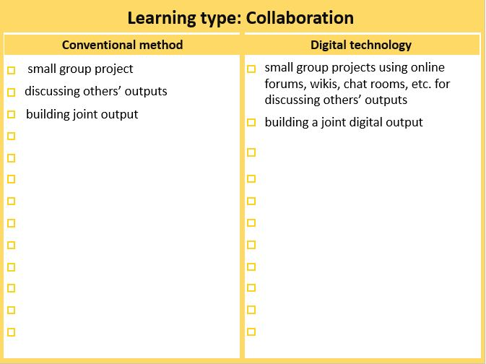
ABC Learning Design

Slide 12
ABC Learning Design

Slide 13
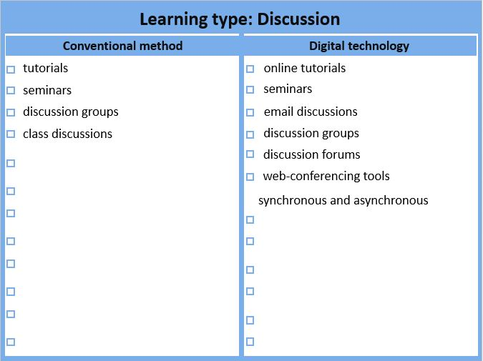
ABC Learning Design

Slide 14
ABC Learning Design

Slide 15
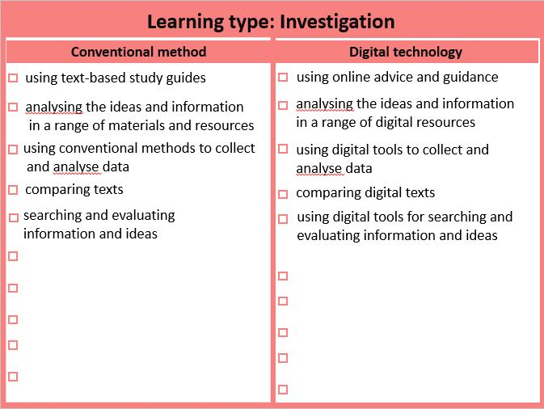
ABC Learning Design

Slide 16
ABC Learning Design

Slide 17
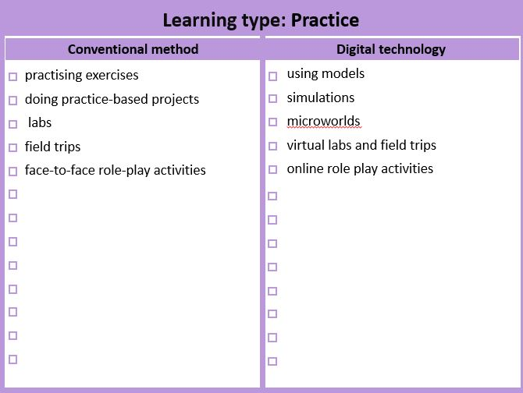
ABC Learning Design

Slide 18
ABC Learning Design

Slide 19
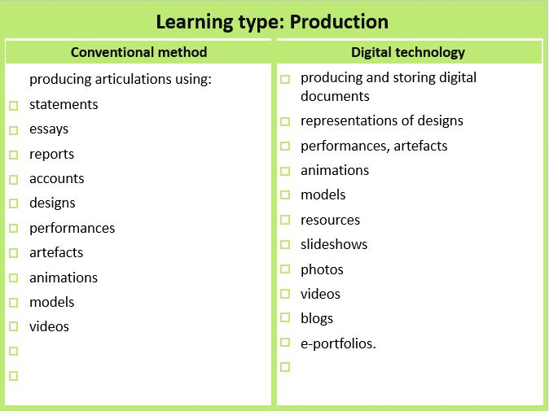
ABC Learning Design

Slide 20
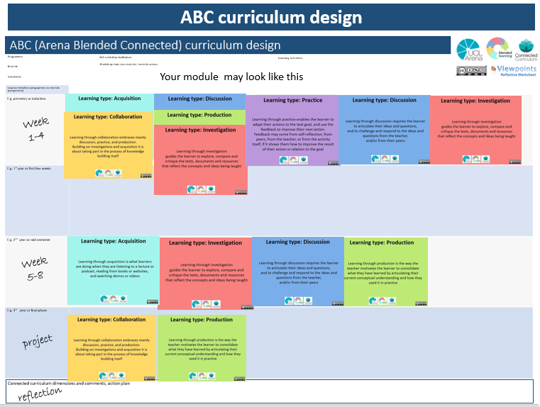
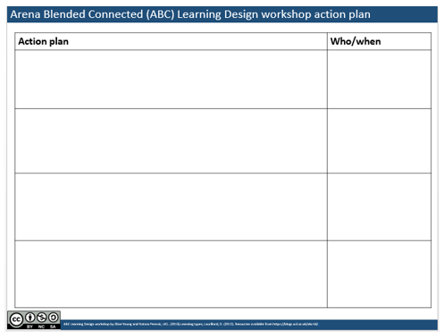
ABC Learning Design
Classic ABC LD workshop schedule:
Module info, tweet and shape
Tweet your module – tweet size description of your module
Module shape (Learning types activities graph) distribution of learning types
Blend – (blended graph)
Storyboard of student journey
Storyboard – learning types sequences and activities
Assessment – align activities and assessment
Module info, tweet and shape
Review the graphs – what has changed? Why?
Actions – what next for team?

Slide 21
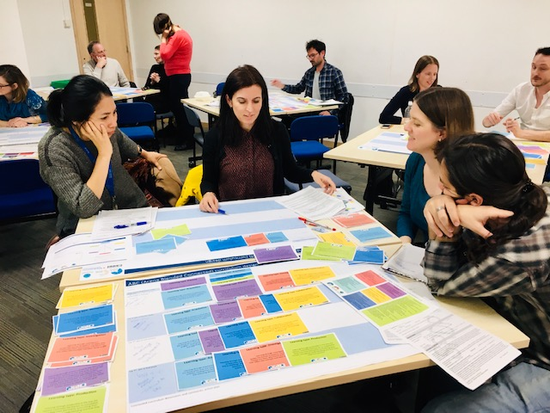
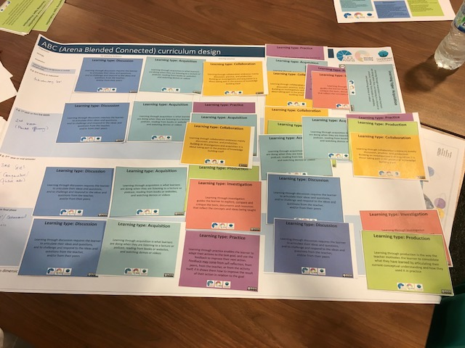
The student journey is built from sequences and combinations of activities – the ‘storyboard’

Slide 22
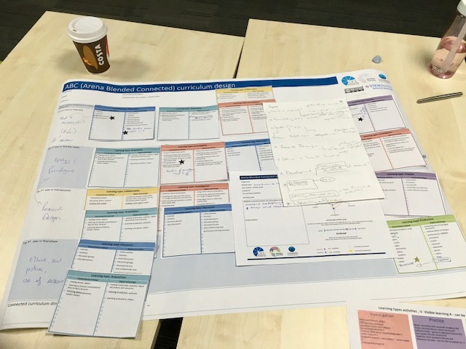
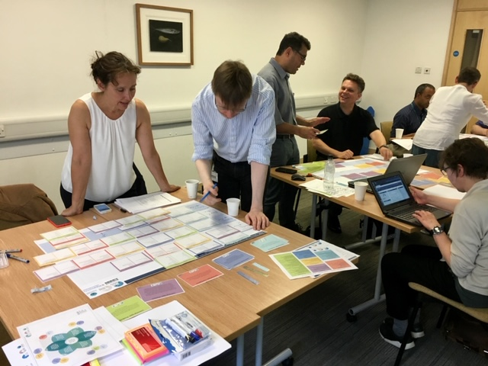
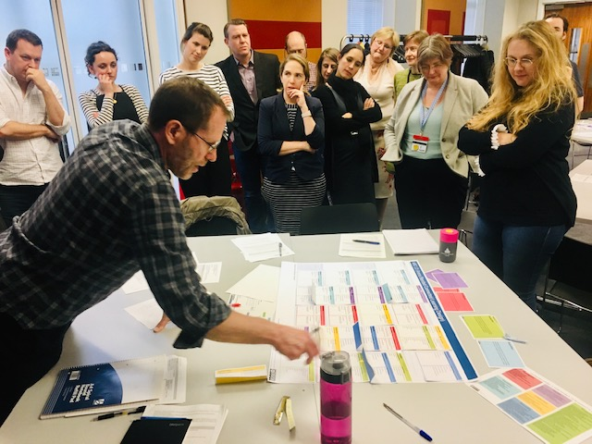
In-person ABC - module teams develop a large storyboard together, then discuss in room
ABC Learning Design + professional skills

Slide 23
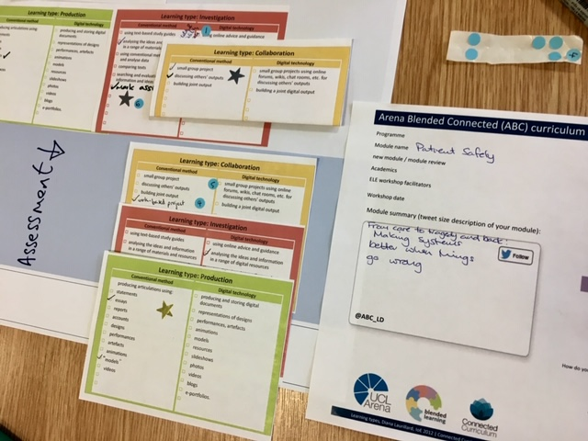
Look at specific components – follow-up workshops
Assessment and feedback
Module, programme outcomes
Institutional strategies
Professional body requirements
Student involvement and feedback
Analytics
Online/offline
Synchronous/asynchronous
Group/individual

Slide 24
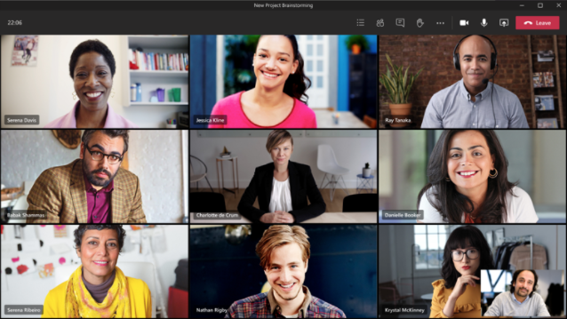
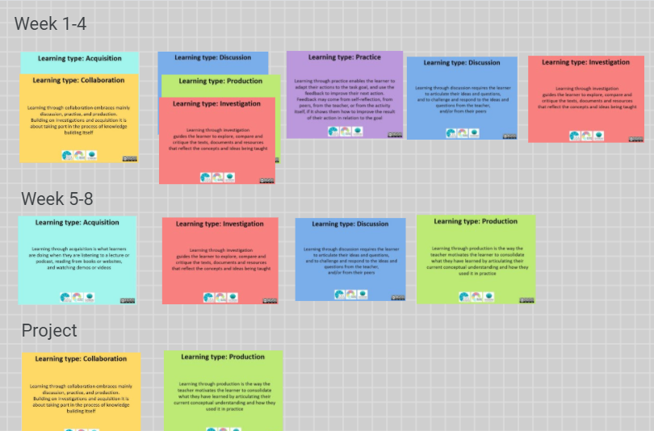
Online ABC - MS Teams and Google JamBoard, uses (almost) the same format

Slide 25
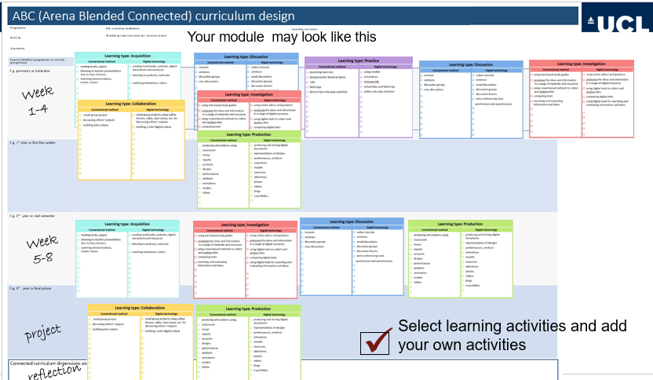
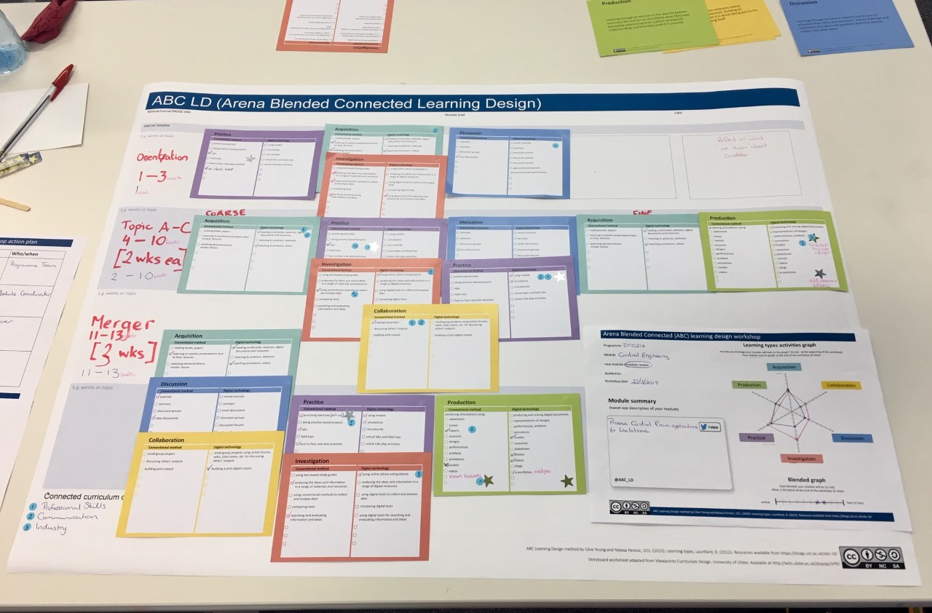
Deciding on activities (in person)

Slide 26
ABC LD workshop
ABC LD – Online Workshop
Session overview
15' Introduction to the ABC LD method (presentation)
10’ Activity: Tweet your course – @abc_ld
10’ Activity: Learning types graph
15’ Storyboarding (Jamboard)
5’ break
20’ activity: design your module Learning Designer
5’ export demonstration
Further resources:
In preparation for our ABC workshop, participants should watch a short (5 min) video by Diana Laurillard: https://www.youtube.com/watch?v=TSP2YlgTldc&feature=youtu.be.
Jamboard https://jamboard.google.com/d/1PHxGyEK0qk_T1WZYQpwu-vcvn8hP1ozSNgTEGwT_rqI/edit?usp=sharing
ABC LD at UCL https://blogs.ucl.ac.uk/abc-ld/home/online-abc/
Learning Designer Tool https://www.ucl.ac.uk/learning-designer/
ABC Toolkit https://abc-ld.org/

Slide 27
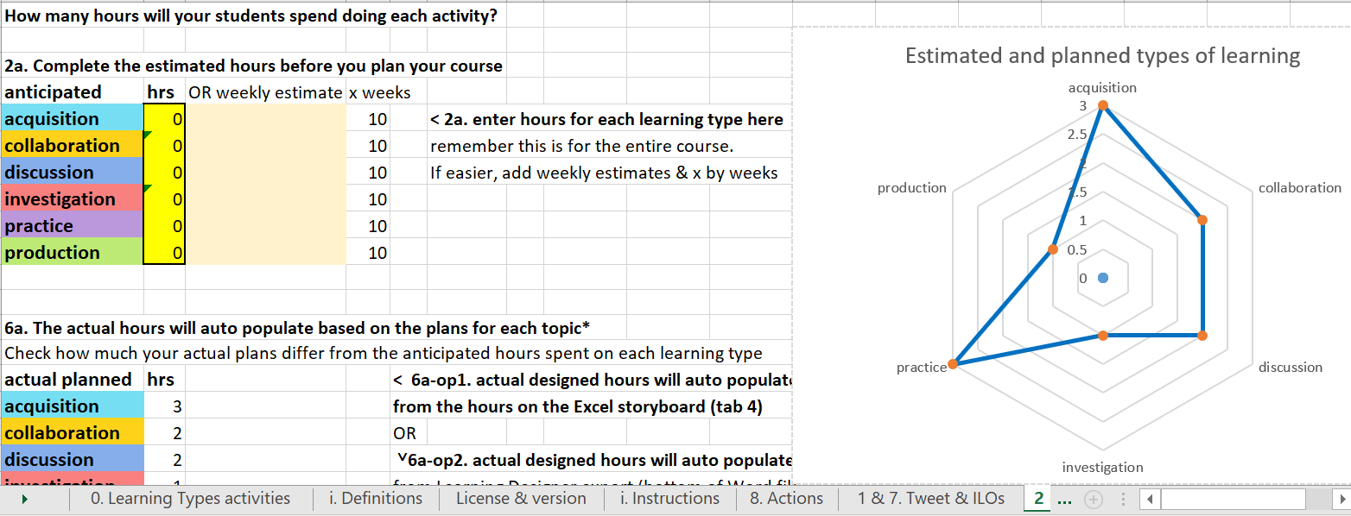
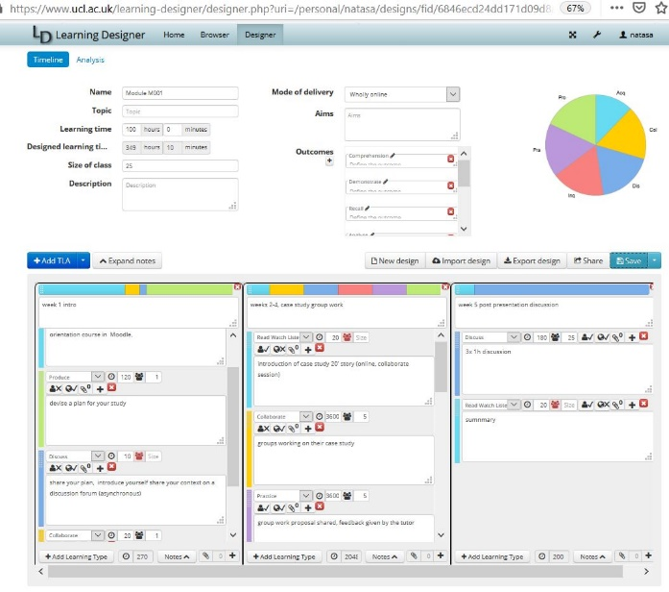
Online ABC Workshop
Module info, tweet and shape
Tweet your module – tweet size description of your course (share on jamboard or tweet)
Module shape (Learning types activities graph) distribution of learning types
Storyboard of student journey in Jamboard
Storyboard – learning types sequences and activities
Transfer into Learning Designer and export to MS Word/Moodle
Module info, tweet and shape
Review the graph – what has changed? Why?
Actions – what next for team?

Slide 28
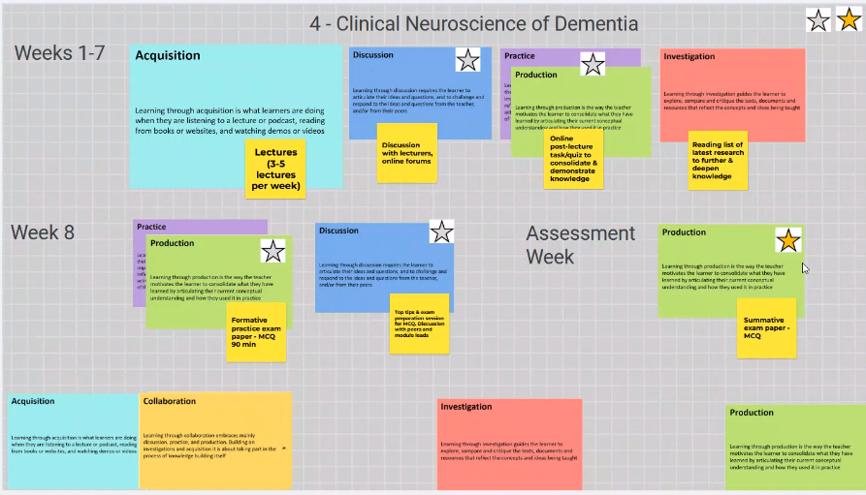
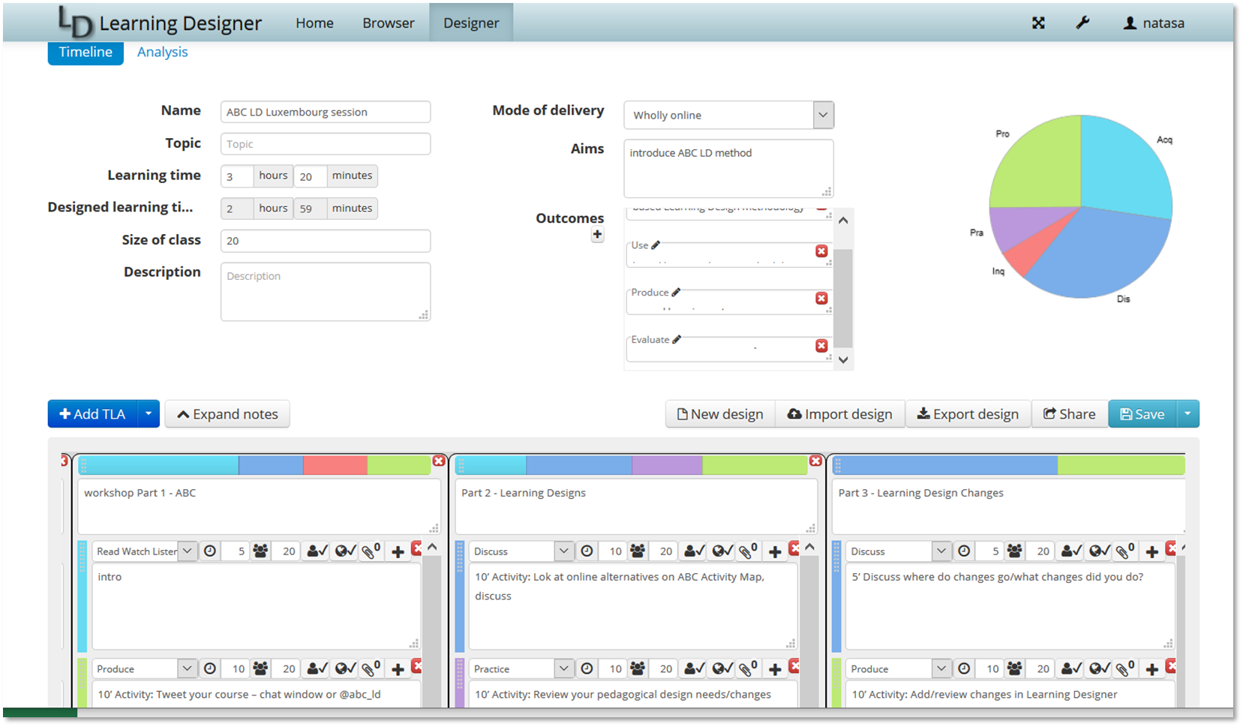
Online activities - Jamboard + Learning Designer (optional)
https://www.ucl.ac.uk/learning-designer/

Slide 29
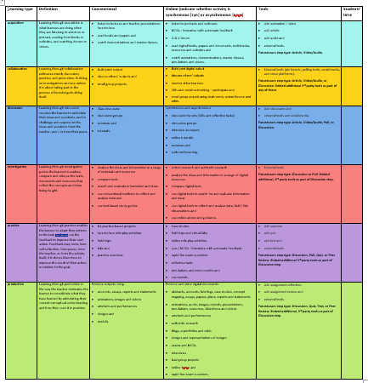
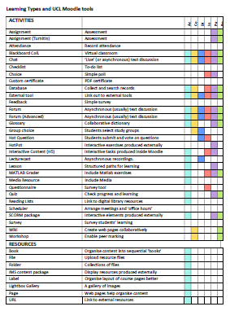
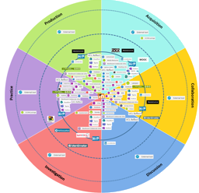
Pedagogy to technology

Slide 30
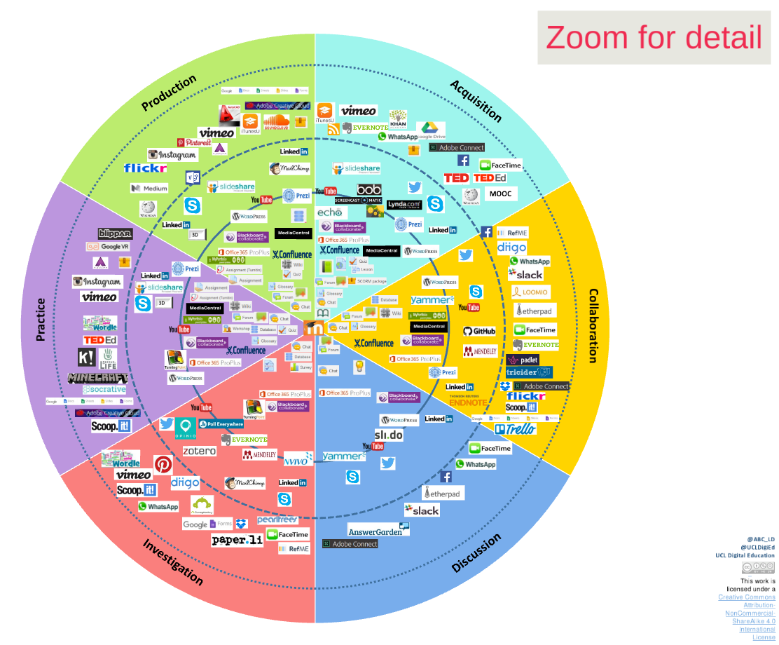
Pedagogy to technology
DRAFT

Slide 31
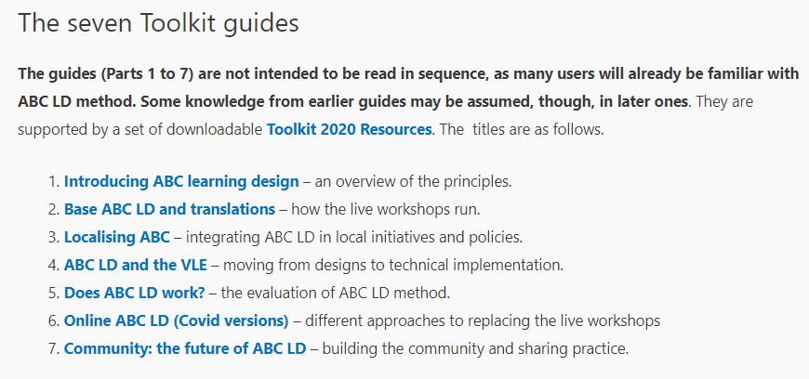
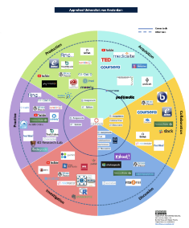
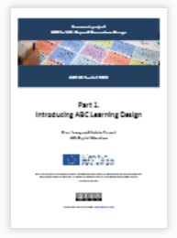
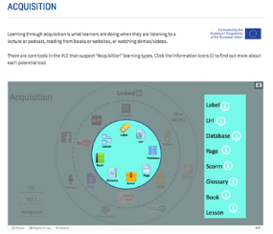
https://abc-ld.org/abc-learning-design-toolkit-2020/

Slide 32
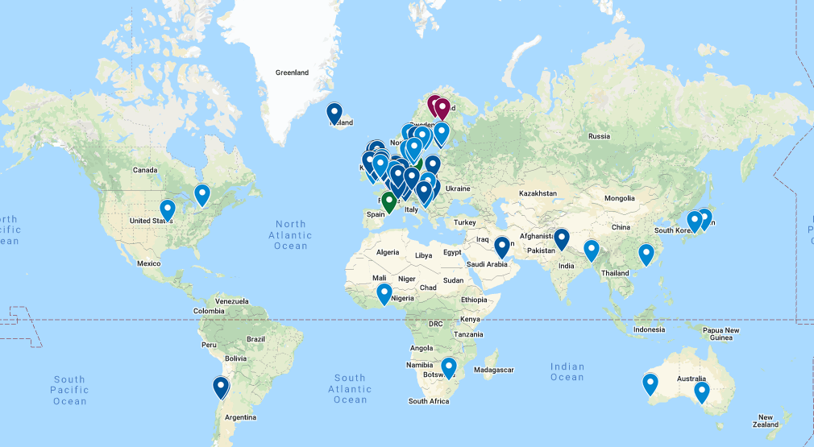
ABC international community
https://www.google.com/maps/d/u/1/edit?mid=1984g8VfPXOA_Z75wgBMy0wCN05E&ll=4.576999366609691%2C0&z=2

Slide 33
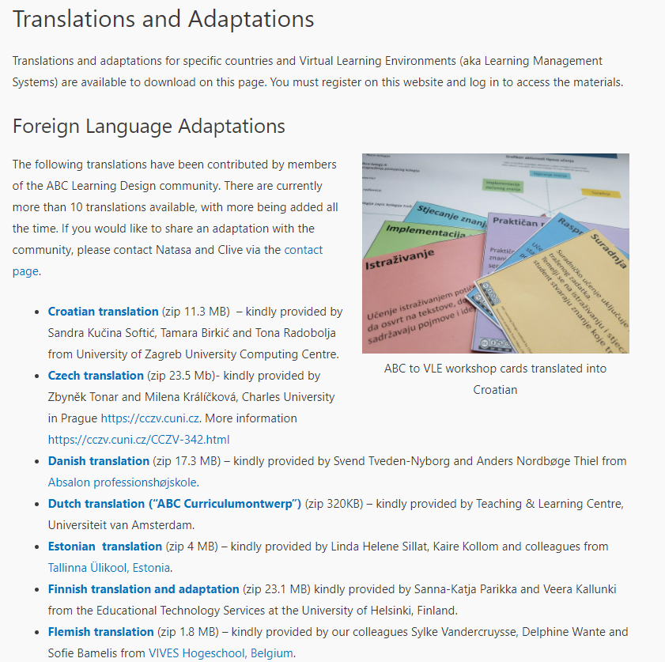
17 Translations
Translations and Adaptations – ABC Learning Design (abc-ld.org)

Slide 34
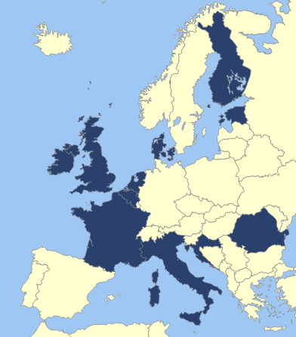
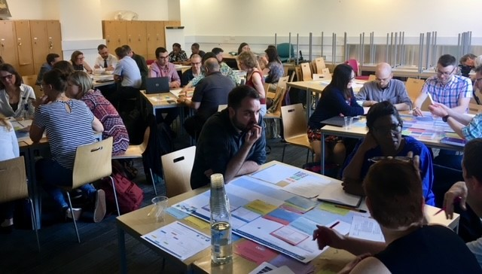
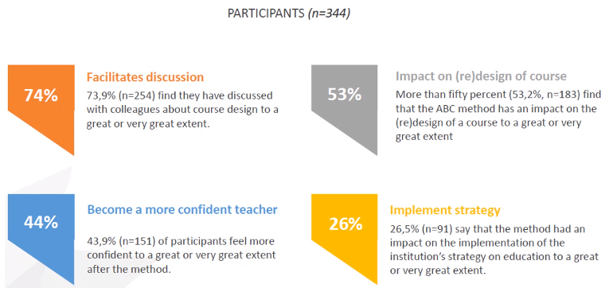
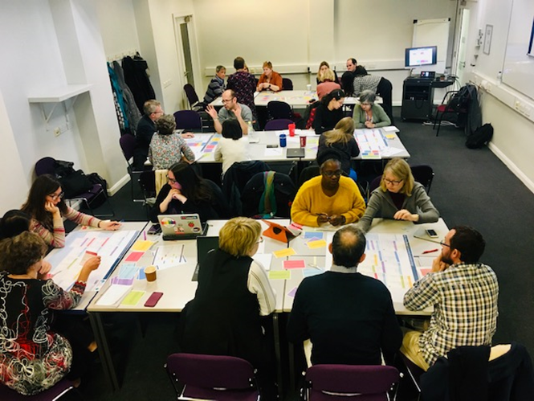
Scalable and effective
https://abc-ld.org/evaluation/

Slide 35
ABC
Learning
Design
Online
https://abc-ld.org/online-abc-ld/

